Slide 1
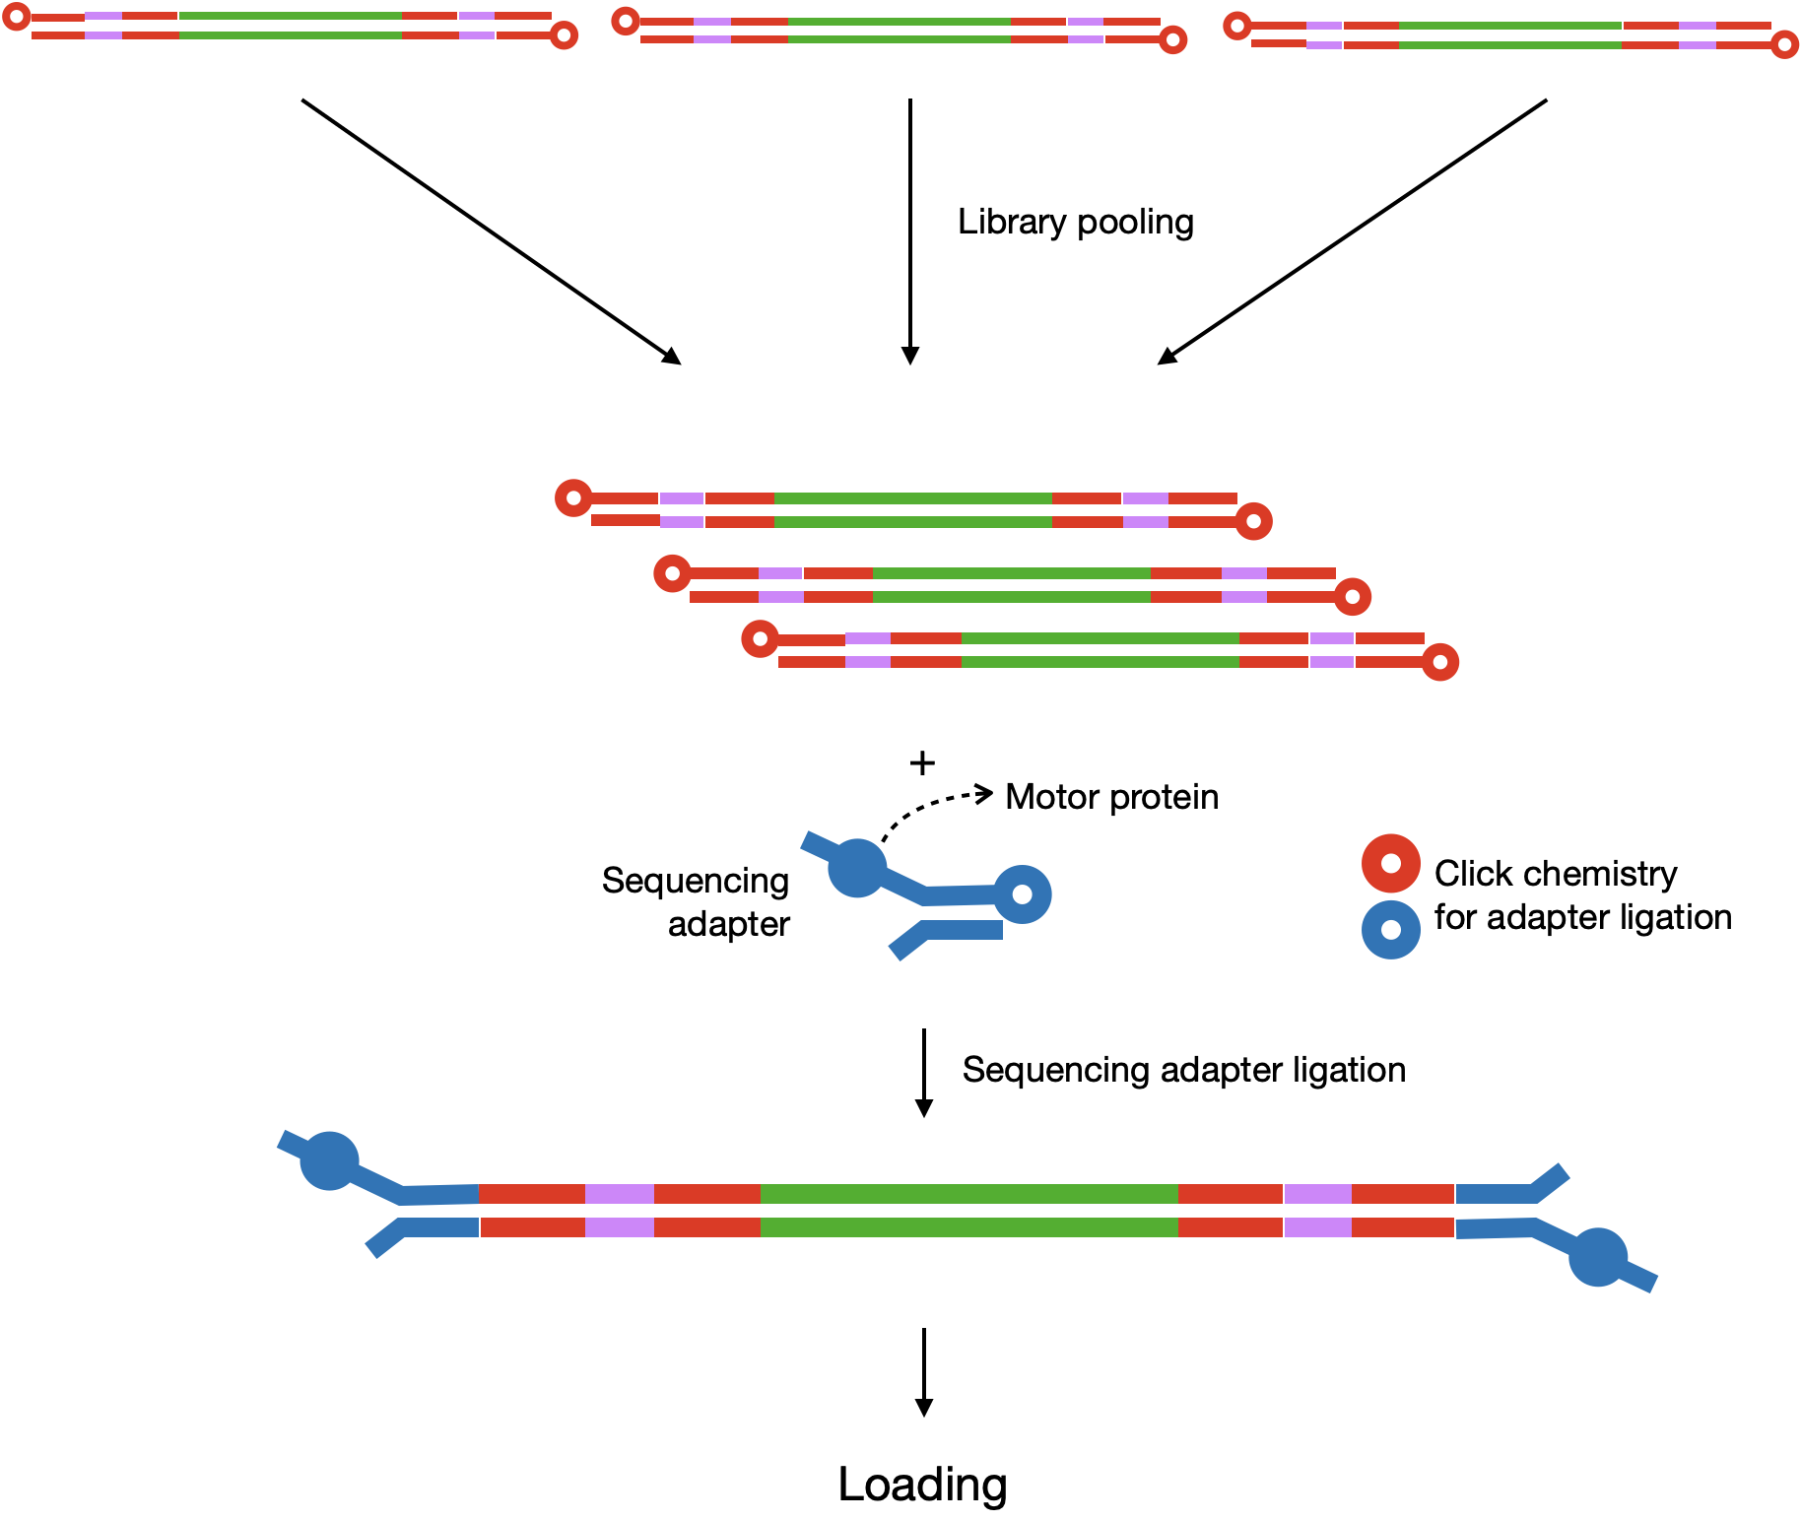
Nanopore RNA and DNA library prep for mNGS
Rapid Response – Updated September 2026

Slide 2

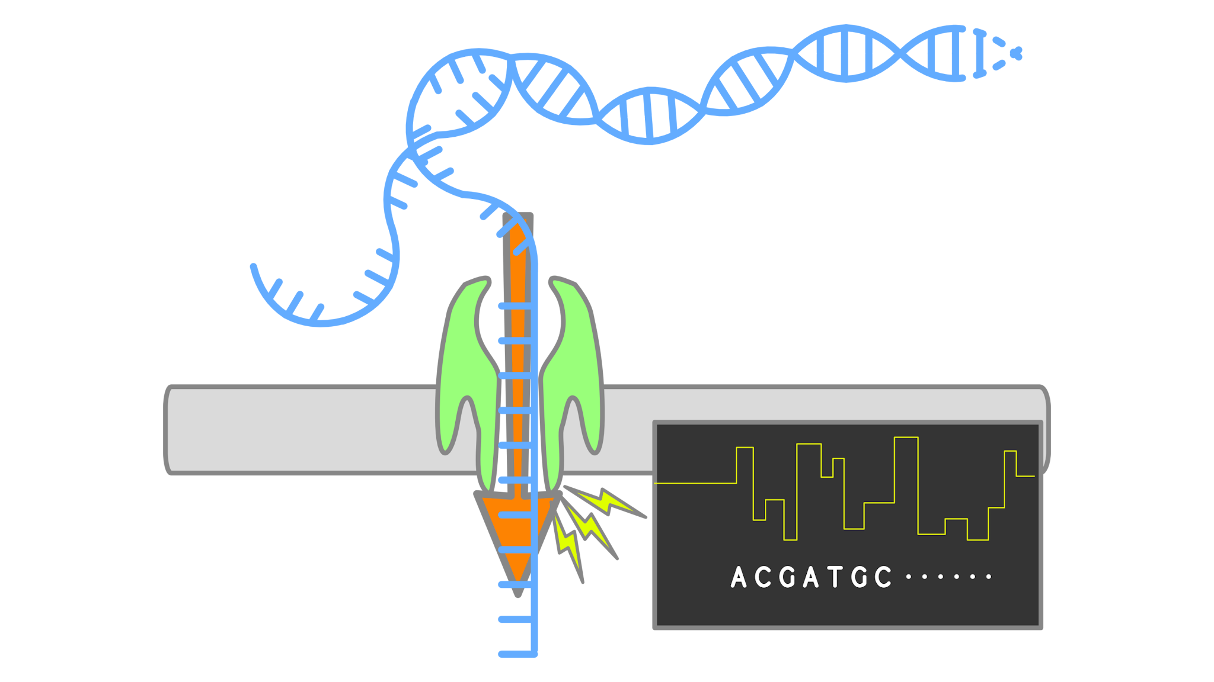



mNGS pipeline
Study design
Nucleic acid extraction
Library prep
Sequencing
Data analysis
Pathogen ID

Slide 3
Considerations when using Nanopore (ONT) sequencing
Sample integrity
    Important to ensure high quality nucleic acid with little to no degradation
    Optimize sample handling and storage
Library preparation kit (link to available kits)
  DNA or RNA?
  PCR or PCR-free?
  Multiplexing or single sample?

Slide 4
Considerations when using Nanopore (ONT) sequencing
Sample integrity
    Important to ensure high quality nucleic acid with little to no degradation
    Optimize sample handling and storage
Library preparation kit (link to available kits)
  DNA or RNA?
  PCR or PCR-free?
  Multiplexing or single sample?
Kit used for ONT RNA mNGS SMART-9N:
Rapid PCR barcoding kit (SQK-RPB114.24)

Slide 5



ONT mNGS pipeline
Study design
xNA extraction
Library prep
Sequencing
Data analysis
Pathogen ID

Slide 6
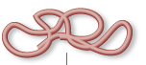

Library prep: RNA to sequencing library
Sequencing library = Pool of DNA inserts with sequencing adapters attached
Extracted RNA
Sequencing library

Slide 7
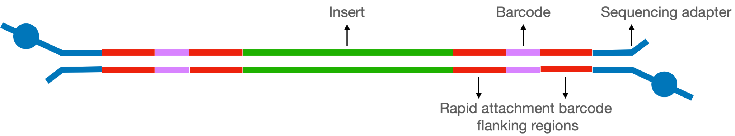
Anatomy of a completed ONT library
Sequencing Adapter
Insert
Barcode
Motor protein
Rapid attachment barcode flanking region 1
Rapid attachment barcode flanking region 2

Slide 8
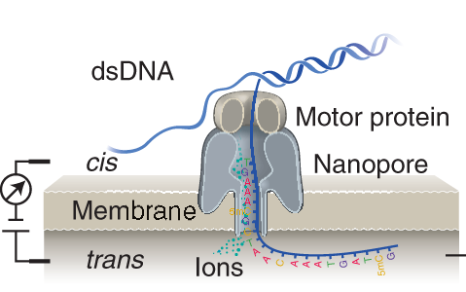
Anatomy of a completed ONT library
Sequencing Adapter
Insert
Barcode
Motor protein
Rapid attachment barcode flanking region 1
Rapid attachment barcode flanking region 2

Slide 9
Anatomy of a completed ONT library
Sequencing Adapter
Insert
Barcode
Motor protein
Rapid attachment barcode flanking region 1
Rapid attachment barcode flanking region 2
Insert: cDNA target that will be sequenced
Rapid attachment barcode flanking region 1: adapter region allows barcode primer to bind for PCR priming; added during cDNA synthesis
Barcode: DNA barcode specific to each sample; added during PCR amplification
Rapid attachment barcode flanking region 2: includes special molecule for sequencing adapter ligation; included in barcode primer, added during PCR amplification
Sequencing adapter: allows binding and movement of DNA through flow cell sequencing pores; includes motor protein; added during sequencing adapter ligation

Slide 10
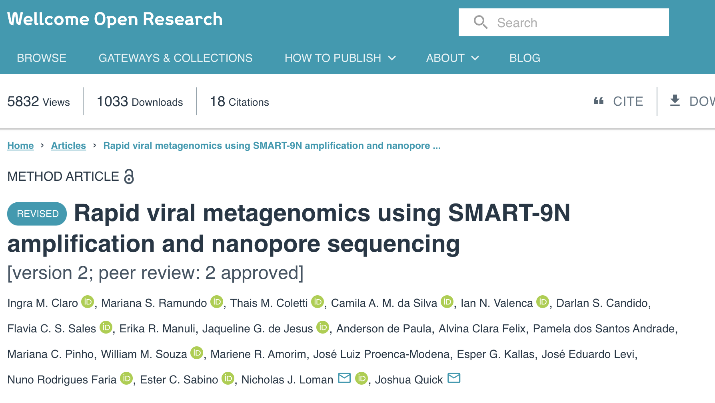
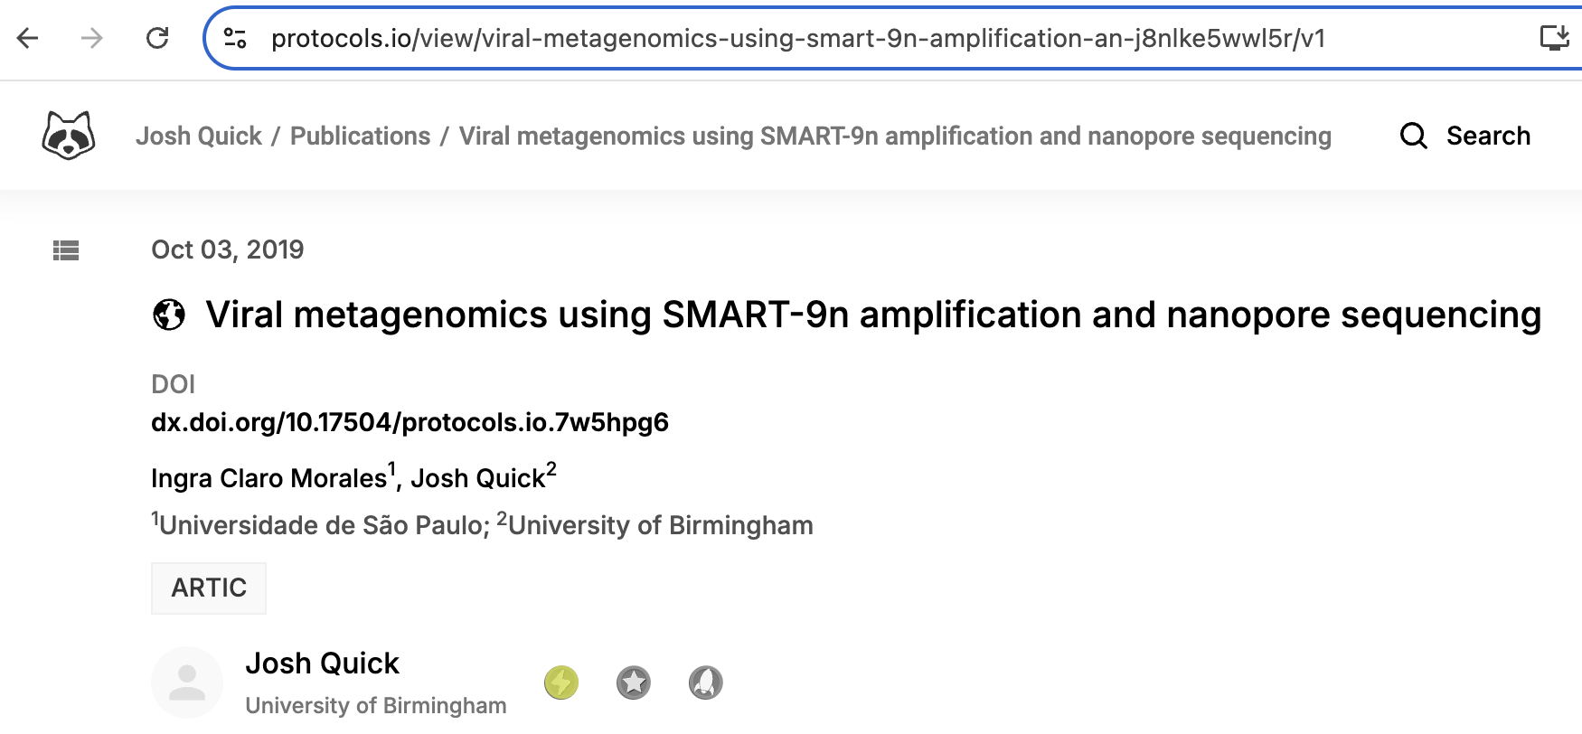
RNA mNGS using Nanopore
  For RNA mNGS using Nanopore, we use the SMART-9N protocol with minor modifications
Increase concentration of oligos for reverse transcription steps
Adjust annealing temperature for PCR
https://doi.org/10.12688/wellcomeopenres.17170.2
dx.doi.org/10.17504/protocols.io.7w5hpg6

Slide 11
Steps in RNA mNGS library prep for ONT (SMART-9N)
Annealing
Reverse transcription + template switching
Barcoding PCR
Clean-up, quantification, and pooling
Sequencing adapter ligation

Slide 12
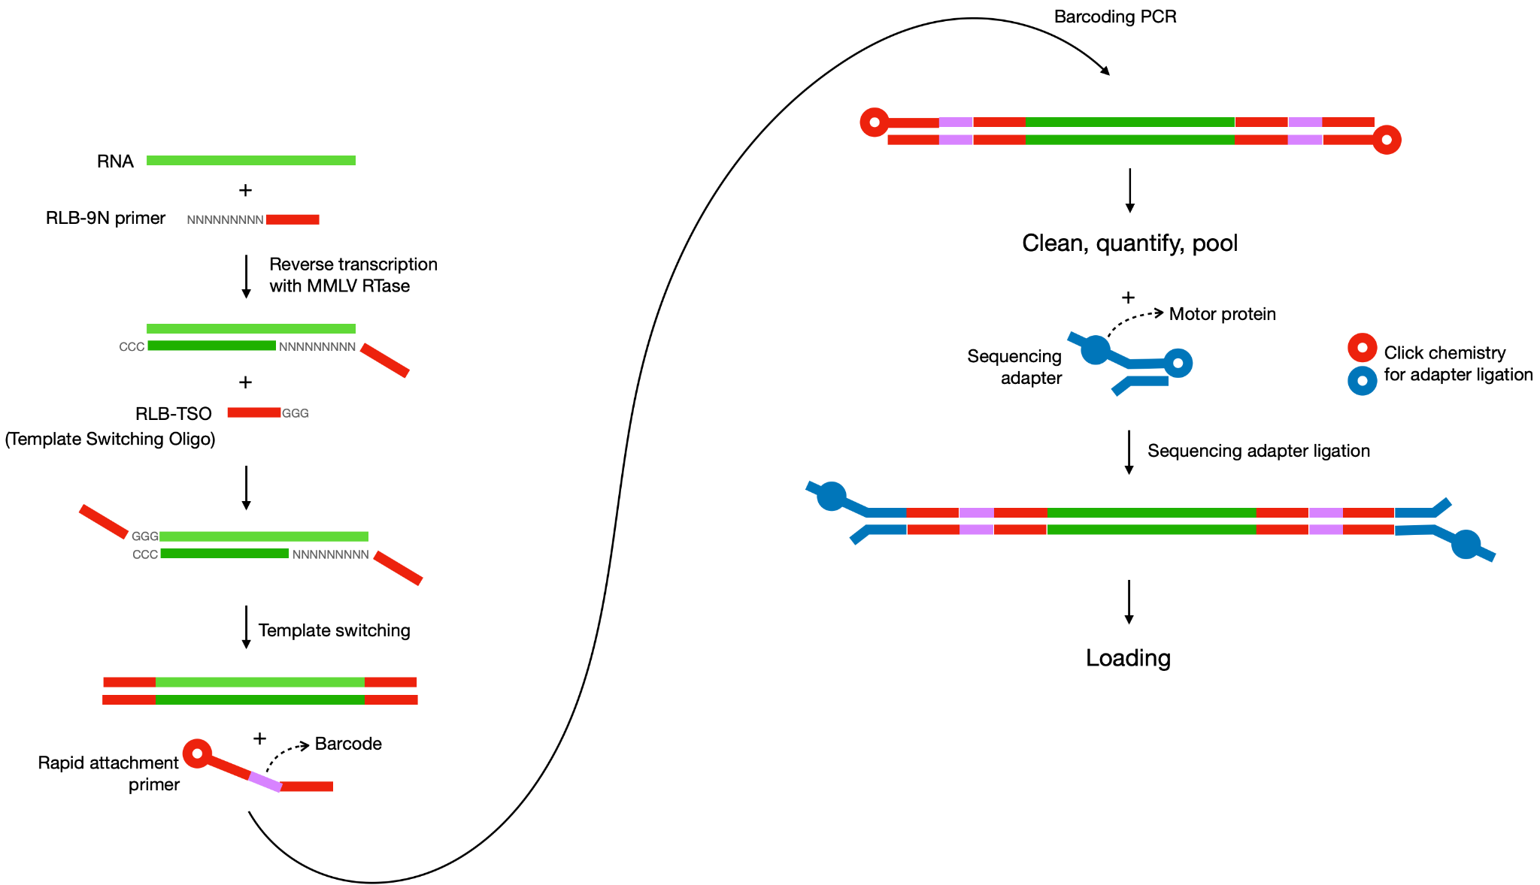
RNA mNGS library prep for ONT (SMART-9N)

Slide 13
RNA mNGS library prep for ONT (SMART-9N)
STEP 0. Starting material: RNA or TNA
(pre-PCR lab)
  RNA only: move on to annealing and reverse transcription
  TNA (total nucleic acid): need to remove DNA
    Aliquot sample
    DNAse treatment
    SPRI bead cleanup (2x)
    Qubit quantification

Slide 14
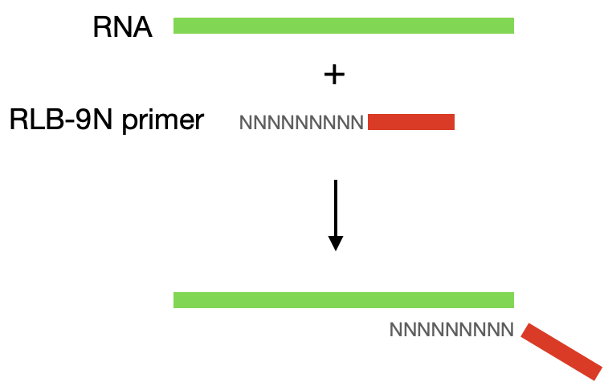
RNA mNGS library prep for ONT (SMART-9N)
STEP 1. Annealing
(pre-PCR lab)
RLB-9N primer: ONT adaptor with random nonamer
ONT adaptor sequence corresponds to the transposase adapter used in Rapid PCR Barcoding kit

Slide 15
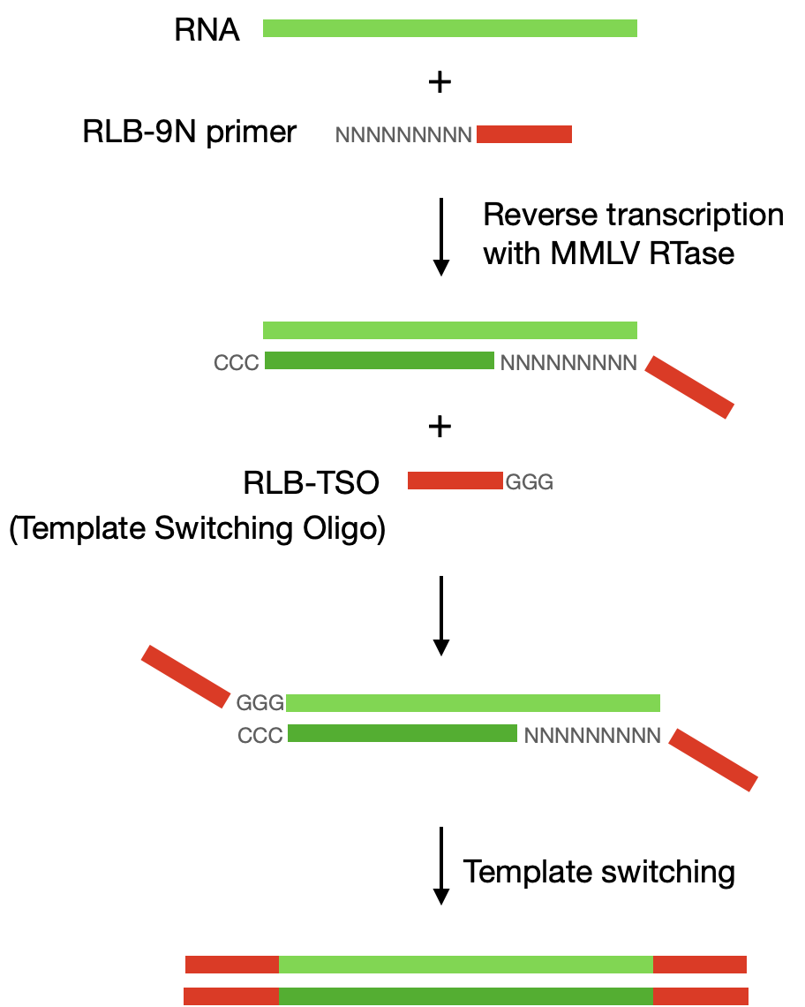
RNA mNGS library prep for ONT (SMART-9N)
STEP 2. Reverse transcription + template switching (pre-PCR lab)
RNase OUT + DTT → degrade any RNases present
Special RTase is used that adds CCC at the end (MMLV)
RLB-TSO: Template Switching Oligo → anneals to CCC and generates the template switched oligo

Slide 16
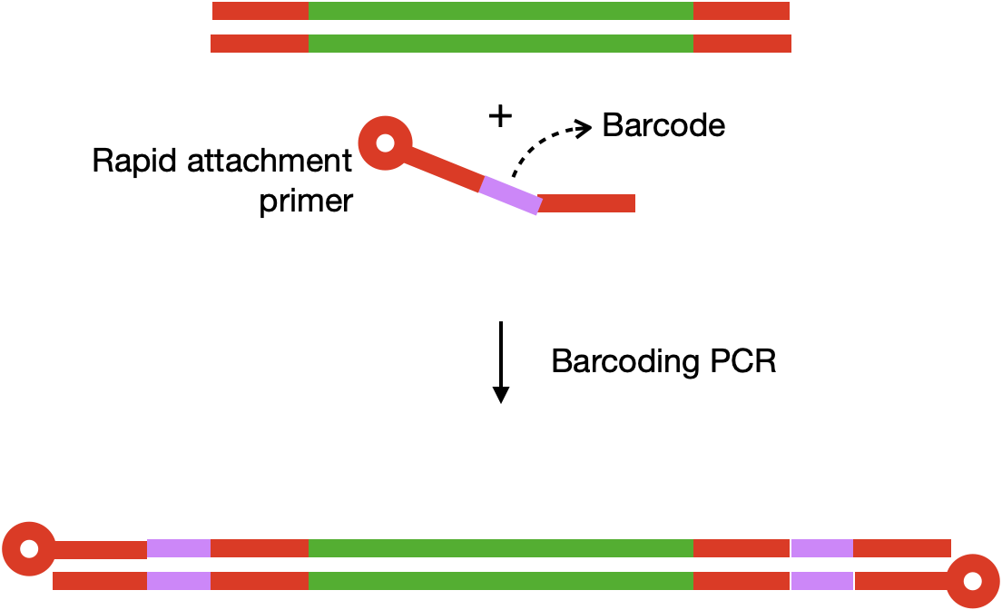
RNA mNGS library prep for ONT (SMART-9N)
STEP 3. Barcoding PCR
(prep pre-PCR lab, amplify in post-PCR)
Barcoding primers: single barcode, same primer amplifies both ends of each sample
Barcoding primers have a modified end to facilitate sequencing adapter ligation
ONT calls these “single rapid attachment primers” and they come with the ONT kit
PCR conditions:
  Number of PCR cycles depends on the input; for low input, perform 25 cycles
  Long extension time used since samples are unfragmented

Slide 17
RNA mNGS library prep for ONT (SMART-9N)
STEP 4. Clean-up, QC, and pooling
(post-PCR lab)
Perform 0.6x SPRI clean-up of libraries after barcoding PCR
Do QC (quantity and quality)
  If running Tapestation, use the genomic screentape
  Ideal size range should be ~1000-7000 bp
Pooling
  The goal is to have 100-150 fmol of library in 11µL
  (This corresponds to a concentration of 10-15 nM)
  Pooling can be done in nuclease-free water or EB as the kit says (anecdotally, water works better)

Slide 18
RNA mNGS library prep for ONT (SMART-9N)
STEP 5. Sequencing adapter ligation
(post-PCR lab, immediately before sequencing)
ONT sequencing adapters have a motor protein attached to it that helps guide the DNA through the nanopores
Ligation of adapter occurs in 5 min using a proprietary click chemistry

Slide 19
Introduction to
SPRI Clean-ups

Slide 20
What are SPRI beads?
Solid-phase Reversible Immobilization (SPRI) beads are paramagnetic beads used for purification and size selection of nucleic acids such as:
  PCR amplicons
  NGS libraries
  RNA/DNA

Slide 21
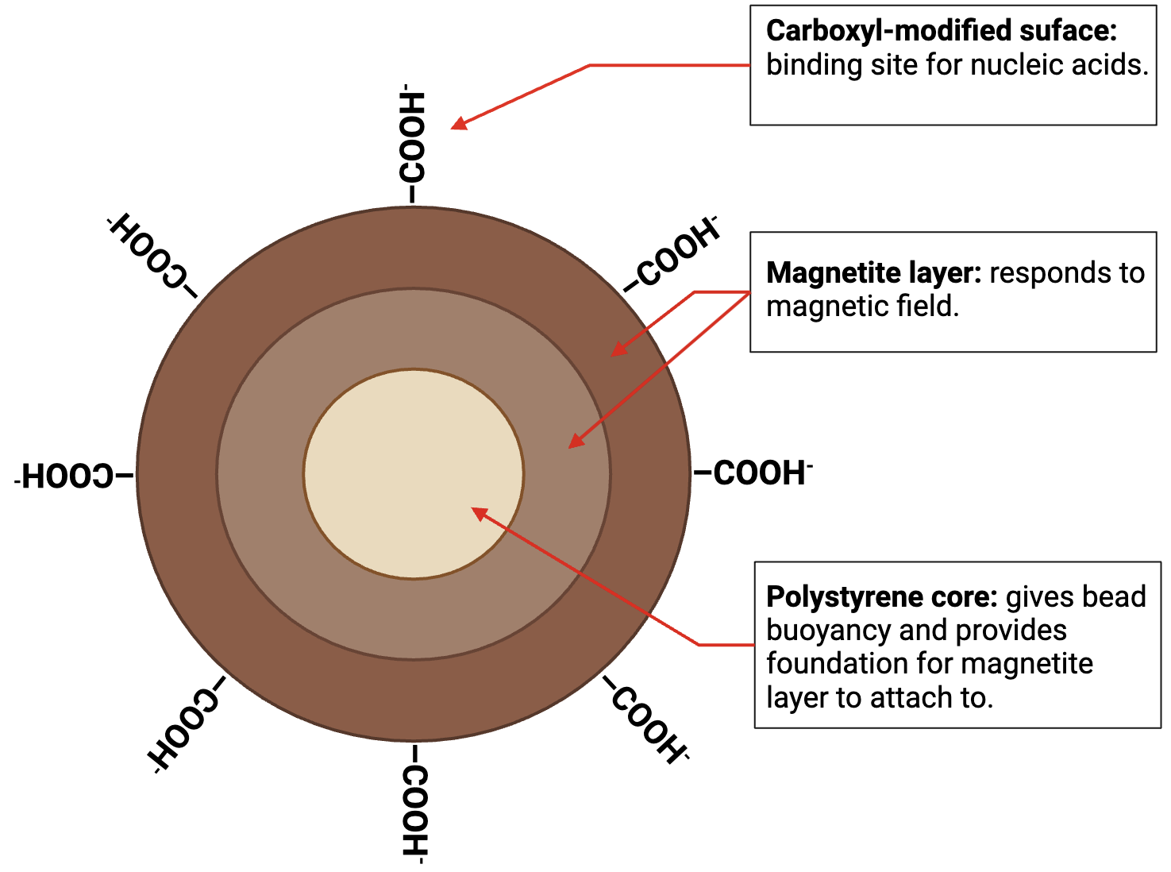
What are SPRI beads?

Slide 22
How do SPRI beads work? Purification
Under the right conditions, nucleic acids precipitate on the surface of the beads. The following are required:
  Crowding agent to force nucleic acids out of solution.
  High salt concentration to facilitate binding between nucleic acids and beads.
  Magnetic field induction to control movement of nucleic acids.

Slide 23
Contents of SPRI buffer
Content | Use
Polyethylene Glycol (PEG) 8000 | Crowding agent used to minimize space between nucleic acid and beads, favoring their proximity and the nucleic acid precipitating on the surface of the beads.

Slide 24
Contents of SPRI buffer
Content | Use
Polyethylene Glycol (PEG) 8000 | Crowding agent used to minimize space between nucleic acid and beads, favoring their proximity and the nucleic acid precipitating on the surface of the beads.
NaCl | Decreases solubility of nucleic acid, thereby promoting precipitation of nucleic acid on the surface of the beads.

Slide 25
Contents of SPRI buffer
Content | Use
Polyethylene Glycol (PEG) 8000 | Crowding agent used to minimize space between nucleic acid and beads, favoring their proximity and the nucleic acid precipitating on the surface of the beads.
NaCl | Decreases solubility of nucleic acid, thereby promoting precipitation of nucleic acid on the surface of the beads.
Tris-HCl | Regulates pH.

Slide 26
Contents of SPRI buffer
Content | Use
Polyethylene Glycol (PEG) 8000 | Crowding agent used to minimize space between nucleic acid and beads, favoring their proximity and the nucleic acid precipitating on the surface of the beads.
NaCl | Decreases solubility of nucleic acid, thereby promoting precipitation of nucleic acid on the surface of the beads.
Tris-HCl | Regulates pH.
EDTA | Chelating agent which sequesters ions such as Mg2+ and Ca2+ which could fragment/degrade DNA or activate any enzymes (e.g. nucleases) that are present in the sample. Aids in retaining the integrity of the sample.

Slide 27
Contents of SPRI buffer
Content | Use
Polyethylene Glycol (PEG) 8000 | Crowding agent used to minimize space between nucleic acid and beads, favoring their proximity and the nucleic acid precipitating on the surface of the beads.
NaCl | Decreases solubility of nucleic acid, thereby promoting precipitation of nucleic acid on the surface of the beads.
Tris-HCl | Regulates pH.
EDTA | Chelating agent which sequesters ions such as Mg2+ and Ca2+ which could fragment/degrade DNA or activate any enzymes (e.g. nucleases) that are present in the sample. Aids in retaining the integrity of the sample.
Tween 20 | Detergent which decreases the adhesion of nucleic acids to the plastic walls of the tube by obstructing the ionic attraction.

Slide 28
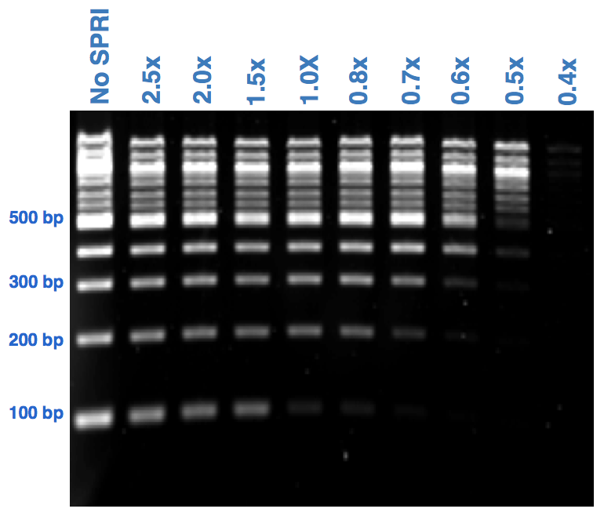
How do SPRI beads work? Size selection
Size selection is dictated by the ratio between the volume of SPRI beads added to your sample and the volume of your sample.
  The higher the SPRI bead to sample volume ratio, the more smaller fragments will be retained.
For a desired SPRI ratio, to determine the volume of SPRI beads to add to your sample, multiply the SPRI ratio by the volume of your sample.
Volume of beads
Volume of reaction
SPRI ratio =

Slide 29
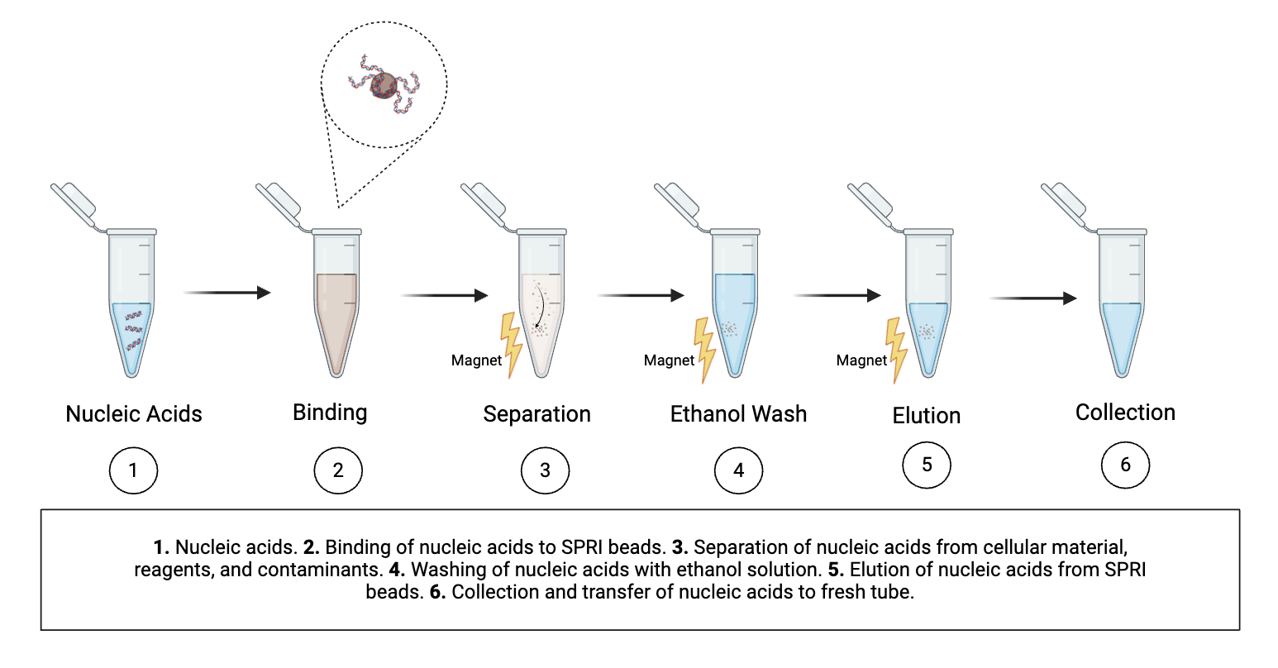
Using SPRI beads in library preparation: The process
Note: Some commercial options are “SPRISelect Bead-Based Reagent” or “AMPure XP Beads”

Slide 30
Using SPRI beads in library preparation: At which steps?
Step | Ideal RNA/library size | To remove | SPRI ratio
After DNAse I treatment | - | Reagents | 2x
After barcoding PCR | > 400 bp | Reagents and small fragments / dimers | 0.6x
After pooling (if the pool needs to be concentrated | - | To concentrate the pool before loading | 2x
Volume of beads
Volume of reaction
SPRI ratio =
Notes:
P7: 24 nt p7 + 12 nt barcode + 2 nt + 32 nt adapter compl.
P5: 20 nt p5 + 9 nt +12 nt barcode + 33 nt adapter compl.

Slide 31
SPRI bead cleanup activity
Set up 2 reactions according to the table below at 0.8X and 2.0X. DNA input is 50bp DNA ladder diluted to 1:50 (save an aliquot to use as a control).
Add SPRI beads to sample and mix thoroughly by pipetting up and down ten times. Incubate for 3-5 mins at room temperature, then pulse spin the tubes for 1-2 seconds,
Place samples on magnetic rack and incubate for ~5 mins on the rack.
Remove supernatant.
Add 200μL of 85% EtOH to samples while on the magnetic rack. Do not disturb beads. Incubate at room temperature for 30s then remove the supernatant.
Repeat EtOH wash step for a total of 2 washes.
Air dry the beads for up to 3-5 mins while on the magnetic rack. Watch beads carefully throughout this incubation to avoid overdrying; smaller bead pellets dry faster. Trust your eyes more than the timer.
Remove tube from magnetic rack. Add 20ul nuclease free water to elute.
Pipette to mix well at least ten times. Incubate for a minimum of 2 mins at room temperature off the magnetic rack, then pulse spin the tubes for 1-2 seconds.
Place on magnetic rack until solution is clear ~5 mins.
Collect 18ul of the supernatant and transfer to a clean nuclease free PCR tube
Bead:Sample | 0.8 : 1 | 2 : 1
50bp ladder 1:50 (μL) | 20 | 20
SPRI beads (μL) | 16 | 40

Slide 32
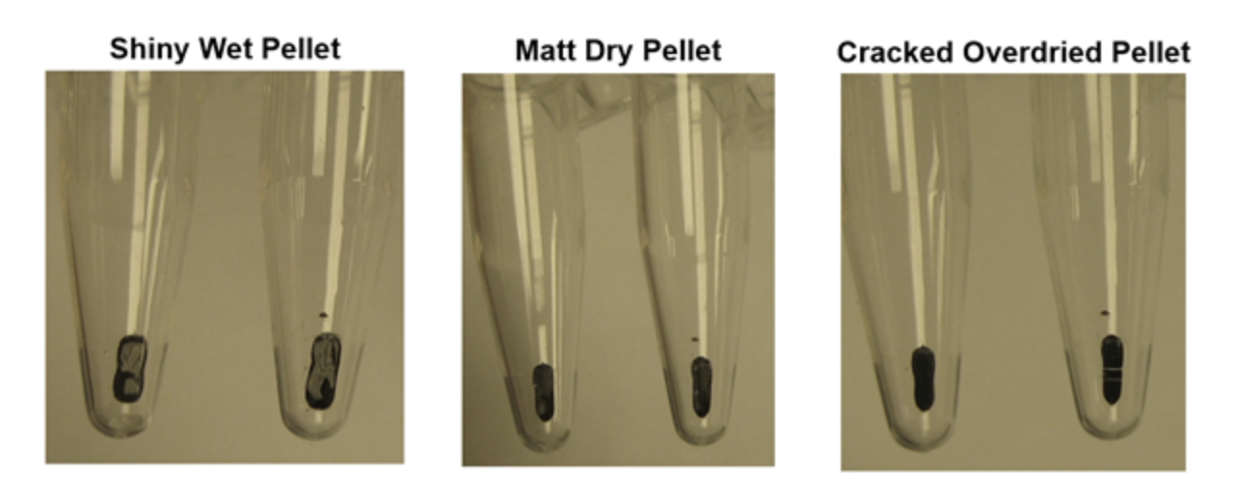
Do not overdry SPRI beads
Shiny, wet pellet Matte, dry pellet Cracked, overdried pellet
Risk of EtOH carryover
Ready for elution
Risk of low yield

Slide 33
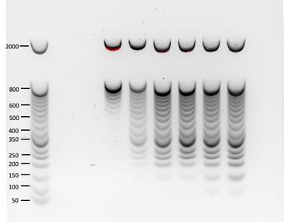
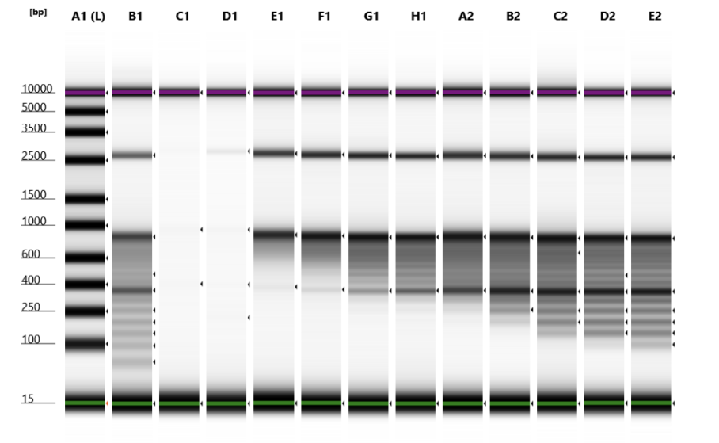
SPRI bead cleanup results
Quantify recovered sample by Qubit dsDNA HS
Visualize samples by agarose gel electrophoresis (1.8% agarose gel and 10000x SYBR GOLD DNA Stain or SYBR-Safe stain), capillary electrophoresis, or automated electrophoresis (TapeStation).
Ladder 0.35 0.5 0.7 0.9 1.1 1.4 1.7 2.0
Ladder 50bp 0.35 0.5 0.7 0.75 0.8 0.85 0.9 1.1 1.4 1.7 2.0
1.8% Agarose
TapeStation

Slide 34
Next : 05-O_Library prep for ONT QC

